Slide 1
The History of Ireland
The Beginning of Records

Slide 2
We’ve looked at Ireland up through the Iron Age, which ends around 400 A.D. And that is where Irish history (as opposed to prehistory) begins.
Although the whole Celtics-come-to-Ireland picture is a little fuzzy, by 400 A.D., a Celtic language that we’ll call Gaelic (it would have been unrecognizable by today’s speakers of Gaelic, just as Old English is virtually unrecognizable by today’s speakers of English) was the native language of Ireland & had been for centuries. So the first Irishman named during the historical period, Niall of the Nine Hostages, spoke Gaelic. Niall claimed (and that word “claim” is important, because we’ll find that there are a lot of “claims” in early Irish history) high kingship of Ireland. (“High kingship” is significant, because there were lots of kings but actually very few who became king of all—or a significant portion of—Ireland.) His descendants are the O’Neills, & they were powerful in Ireland for centuries. As recently as 1969, an O’Neill was in power, as the prime minister of Northern Ireland.
There have been legends written about Niall of the Nine Hostages, so if you decide to look him up, don’t believe everything you read. But he was an actual person, so if you find the right sources, you can learn more about him. One note of importance is that his seat of power was at the Hill of Tara in County Meath. For centuries the high kings of Ireland were crowned at the Hill of Tara.

Slide 3
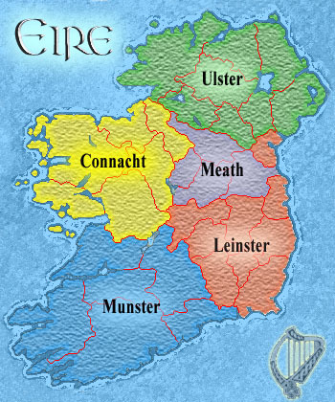
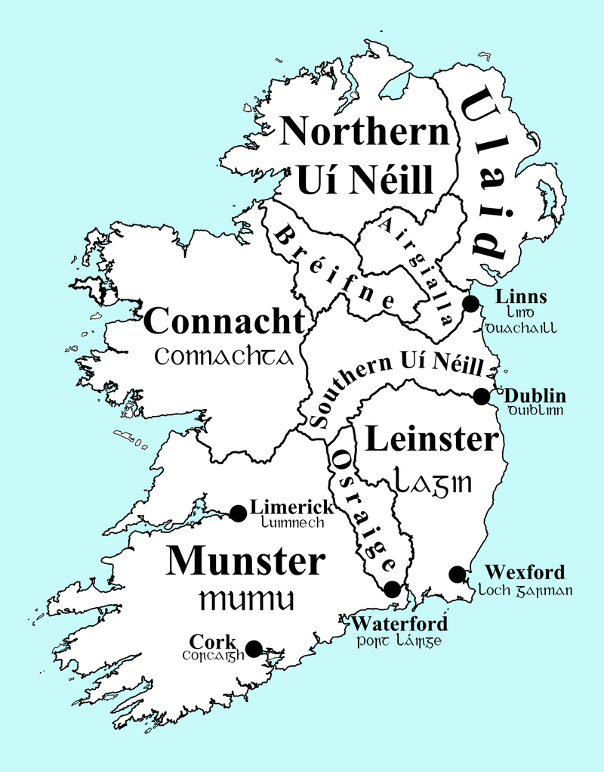
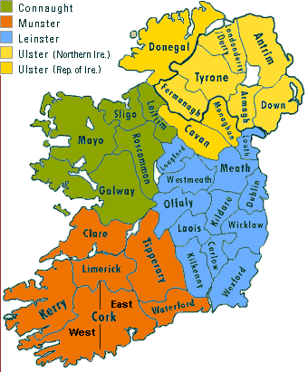
In prehistory & the early historic period, Ireland was divided into five kingdoms, as seen on the map to the right:
Note that “Eire” is the Gaelic name of Ireland. You may also encounter “Erin,” which is a form of “Eire,” but it’s only “Eire” that’s official. The national bus company, Bus Eireann, is pronounced like “Erin.”
Niall of the Nine Hostages changed the map. Not with an Adobe program but with his power and his reproductive prowess.
Note that the map at this point includes a Northern O’Neill (Uí Néill) & a Southern O’Neill. County Meath,
I
where the Hill of Tara is located, was part of Southern
O’Neill. Niall’s descendants were the high kings of Ireland for 6 centuries.
Meath has merged with Leinster, but the
other kingdoms exist today as provinces
divided into 32 counties.

Slide 4
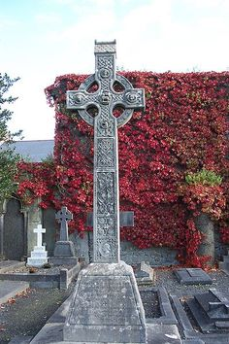
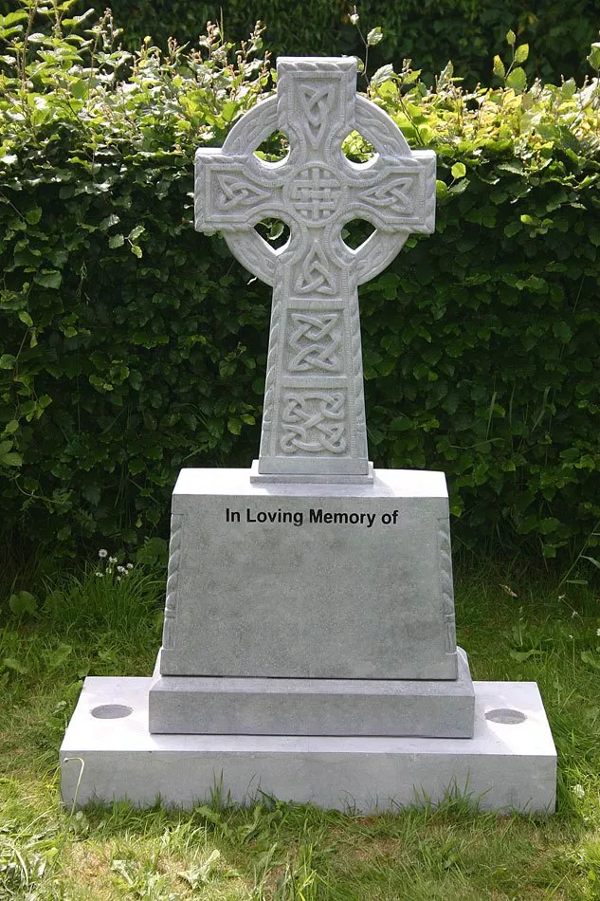
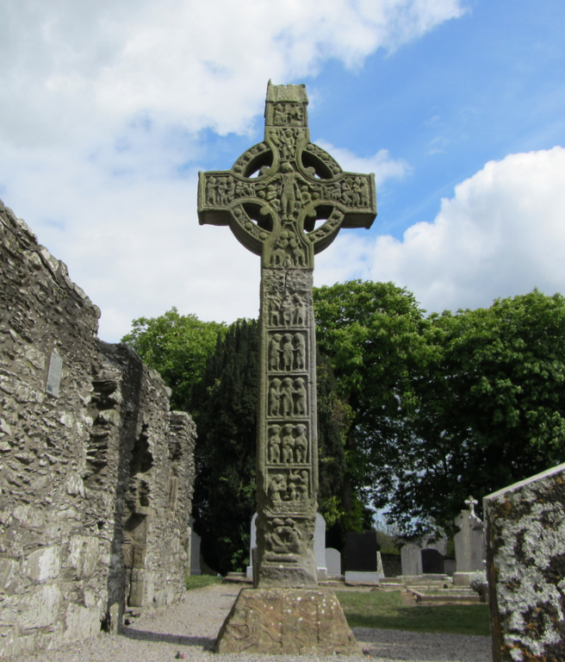
And now it’s time to discuss the world’s best known Irishman: St. Patrick.
And now to disillusion you: St. Patrick wasn’t Irish. He was actually British. As a child, he was captured by Irishmen and taken to Ireland as a slave. Years later, he escaped or was freed & returned to Britain, but then he went back to Ireland as a missionary. He was born in 385 & died in 461, so he was a contemporary of Niall.
Patrick brought Christianity to Ireland. He succeeded in converting people who were polytheistic & probably knew nothing of the God of the Old Testament, let alone of the New Testament. In an earlier slide show, there was a mention of Celtic crosses. “Celtic” involves so much more than religion, so it makes sense that Celtic art would adorn the crosses that began appearing as Christianity spread.

Slide 5
Another patron saint of Ireland (there are 3), not one with his own worldwide holiday but still important in Ireland, was St. Colum Cille (probably better known these days as Columba, from the Latin). He lived about 100 years after Patrick, & he too was a missionary, but from Ireland rather than to Ireland. He founded a monastery on the island of Iona off the coast of Scotland and from there spread Christianity throughout Scotland.
Ireland managed to miss the Roman & Germanic invasions, but in 795, Vikings began attacking them in waves. The first attacks were on the coastal areas, but then they began to move inland & establish settlements. The invasions continued for 200 years, their power for another 100. The Vikings are remembered as plunderers & pillagers who wreaked destruction. More in-depth studies of the evidence, however, suggest that the Vikings, while certainly not gentle souls, did not turn Ireland on its head (Bartlett, p. 33). The different Irish factions had been warring with each other for centuries, & there is no evidence that the Vikings destroyed Irish institutions & their way of life. That’s not to say they didn’t destroy & kill, but their impact on Ireland as a whole was mild when compared to their impact on Britain. (Not much consolation to the Irish of the time, granted.)
If you haven’t noticed yet, in general, one of two processes occurs when a people invades the land of another: either their culture and/or language pretty much replaces what was there before, or the invaders assimilate to the culture of the invaded country. It’s never quite that simple, & when two cultures meet, both are affected, but think about the Roman invasion of Britain. The Britons never spoke Latin. But after the invasion of the Germanic tribes, the people of Britain became Germanic-speaking. A lot of factors are involved; in fact, nothing about the mixing of cultures is simple. But the point here is that the Viking culture & language did not replace the Irish; rather, the Vikings, as they established settlements & raised the ire of the Irish, still intermarried and assimilated to the host country. When their power as Vikings ended in Ireland, there were still Vikings & descendants of Vikings.

Slide 6
It’s important to remember that the Irish weren’t living in peace until the mean old Vikings attacked them. Kingdoms were regularly at war with each other.
In 1165 the king of Leinster, Diarmait Mac Murchadha (we’ll just call him “Leinster” in this section, for simplicity’s sake), was at the war with the king of Connacht for control over the southeast section of the island. He went to King Henry II of England to ask for his help. Henry refused to give him troops but permitted him to recruit mercenaries from Britain.
Leinster went to Wales & succeeded in recruiting not riffraff for the most part but men of noble families. The nobles were having a hard time of it in Wales, finding the Welsh very resistant to English incursion & finding their land holdings less than lucrative. Also, some of those in Wales had fallen out of favor with their English king, so joining Leinster and heading across the Irish Sea didn’t seem like such a bad idea.
Richard Fitzgilbert, earl of Pembroke and much better known as Strongbow for his prowess with the long bow, was one who accepted Leinster’s offer, but he had a condition: he wanted to marry Leinster’s daughter & succeed him as king of Leinster. Leinster agreed.
Remember when the Scottish invited the wolf into the hen house when they asked the then king of England to decide the succession to the Scottish throne? Same thing: inviting the British in to help in local wars was the beginning of the end of the Gaelic language & the beginning of the beginning of centuries of struggles against the British.
To be fair, Strongbow & the other nobles weren’t the problem in & of themselves. They helped Leinster win, Strongbow married his daughter, & he inherited the kingship of Leinster in 1171. Everyone could have lived happily ever after, but Henry was none too happy to find one of his nobles in a neighboring land holding power that could conceivably be a threat to Henry. So 5 months after Strongbow had inherited Leinster, Henry and a large expedition sailed to Ireland

Slide 7
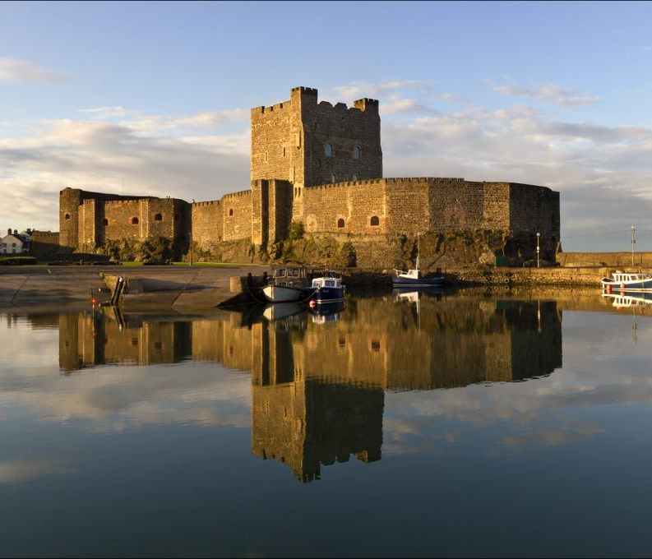
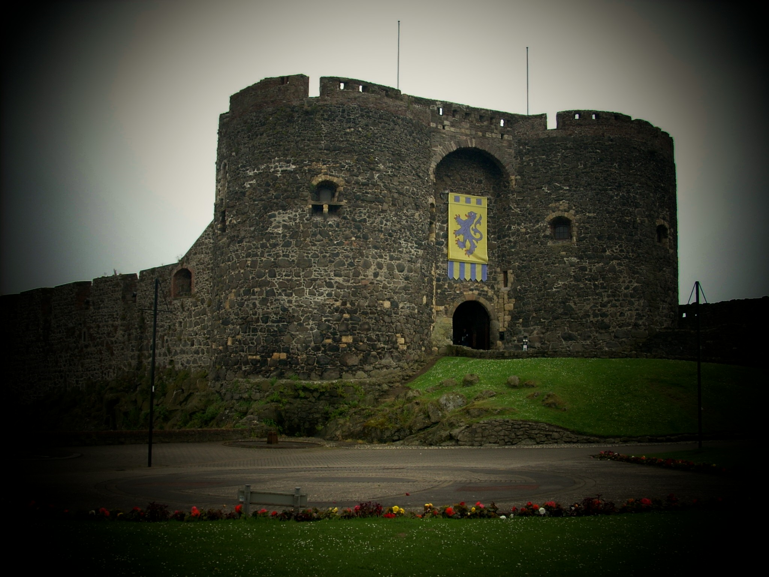
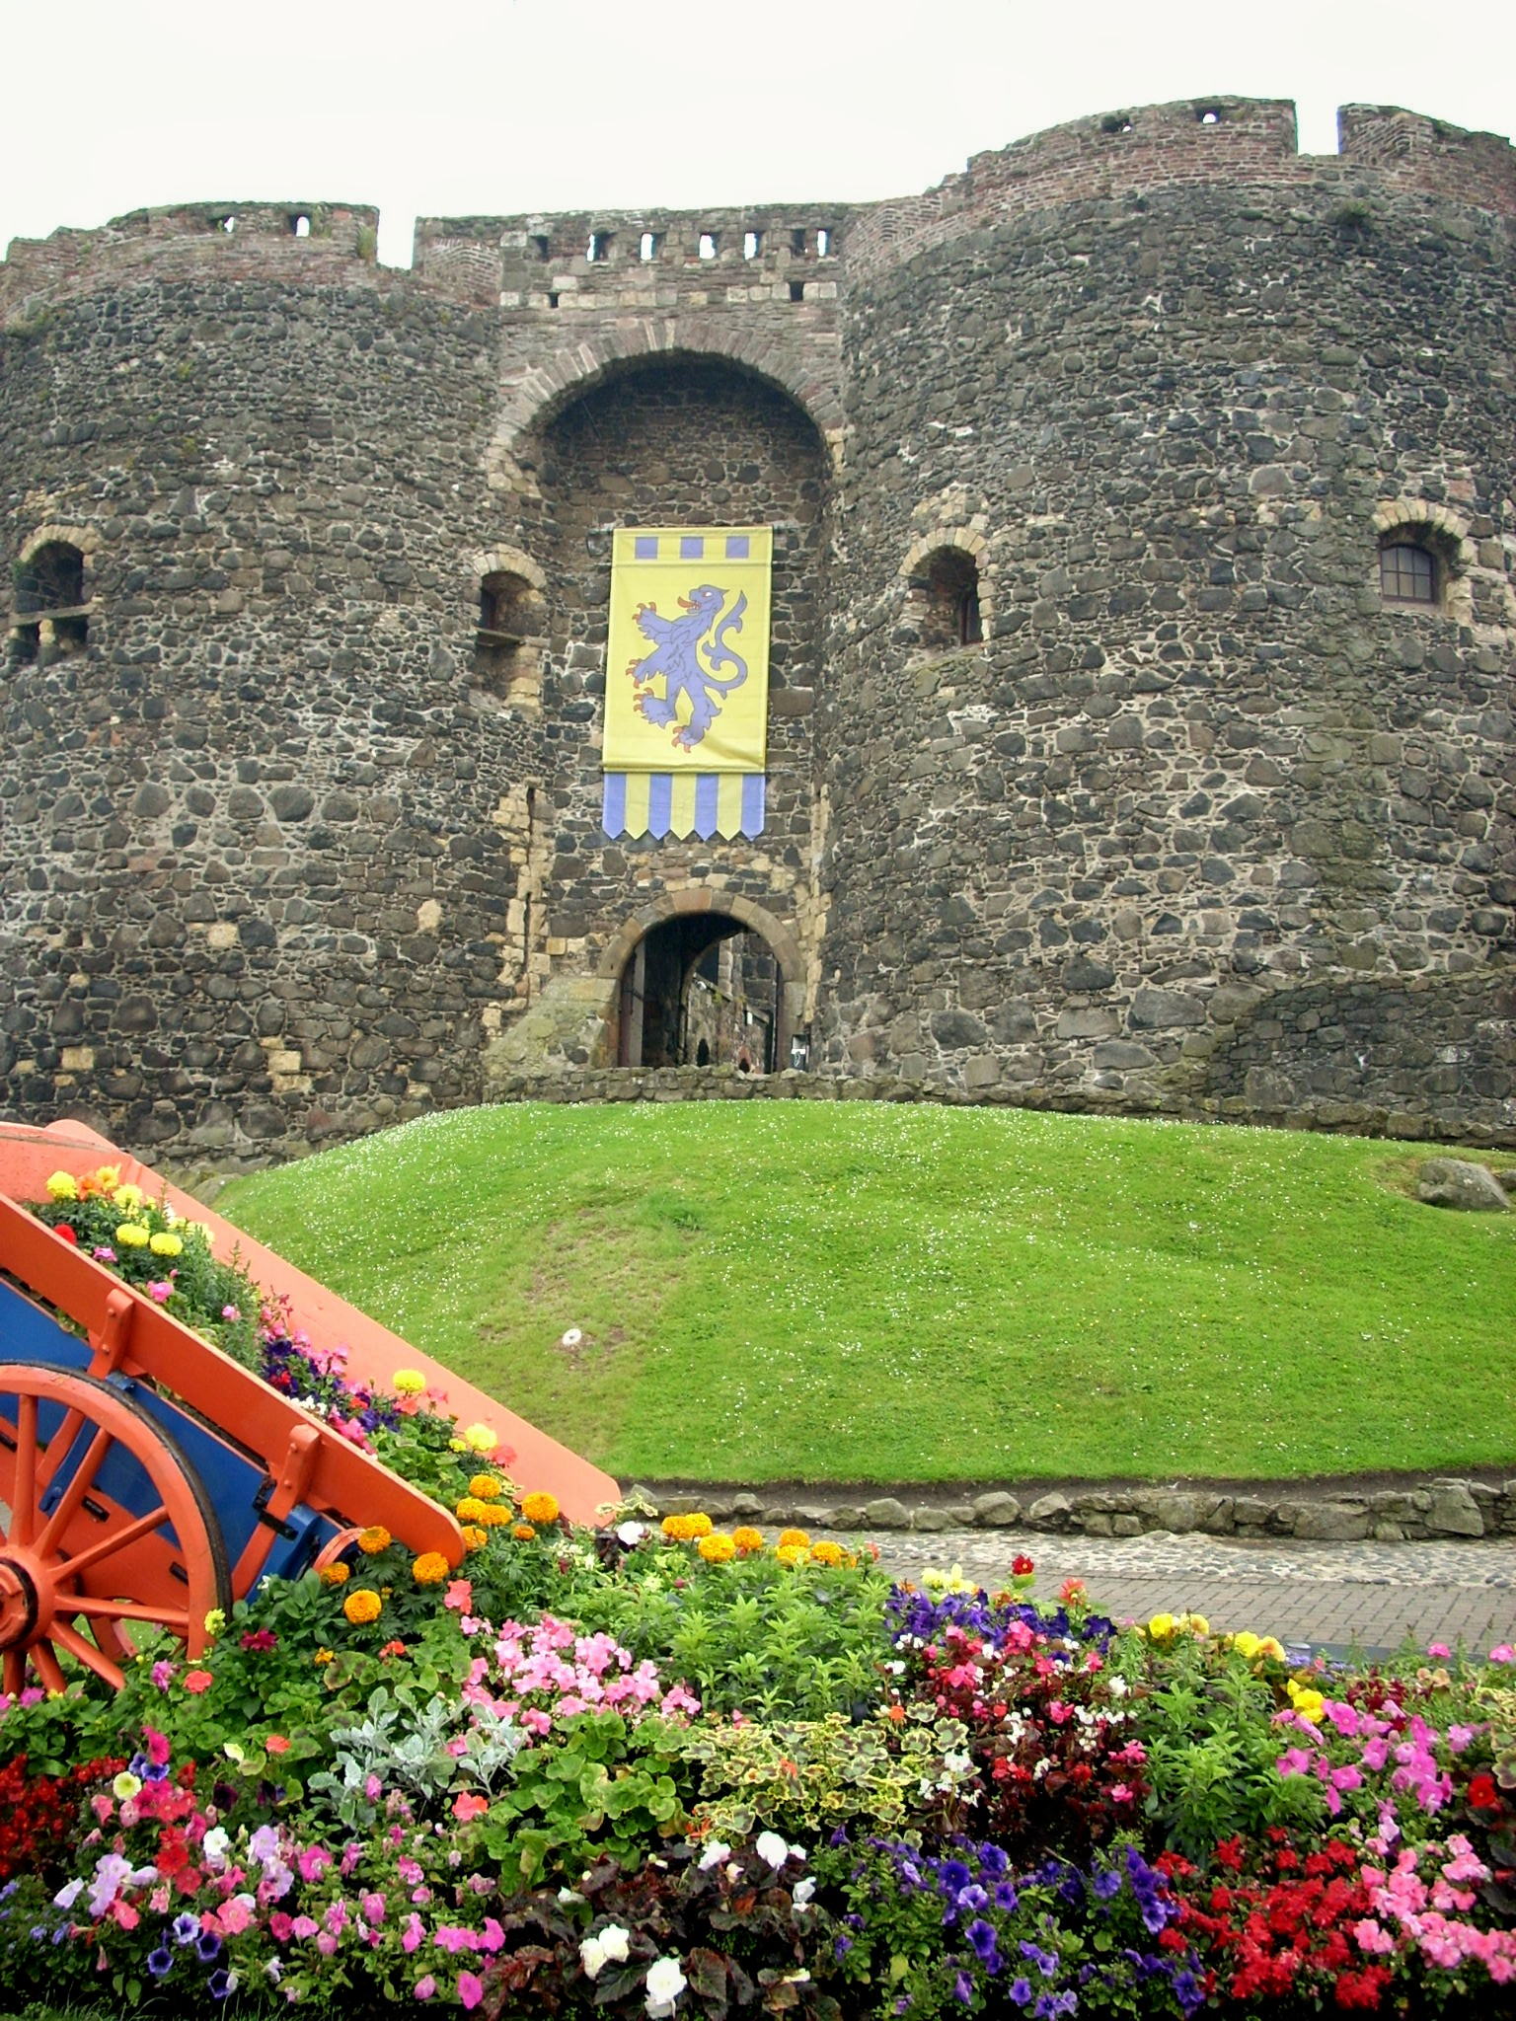
Many of the Irish kings pledged loyalty to Henry II because they weren’t too thrilled with the British barons & thought that he’d come to save them from the barons. Henry, of course, just wanted to establish who was boss. He claimed Dublin, Waterford, & Wexford (lands that Strongbow had helped Leinster conquer) as his own but actually confirmed Strongbow as lord of Leinster. However, just to keep things even, he made Hugh de Lacy, of whose loyalty he was sure, lord of Meath, the location of the Hill of Tara, which was significant, of course.
Strongbow wasn’t the only ambitious English mercenary. John de Courcy raised a small but obviously skilled army and managed to defeat the king of Ulster. In 1177 he built a castle at Carrickfergus, near Belfast, as his seat of power.

Slide 8
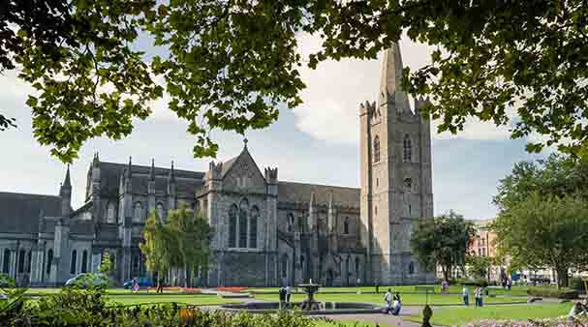
Henry was none too happy about de Courcy’s success. He sent Hugh de Lacy after him, & de Lacy captured & imprisoned de Courcy in 1204. Henry made de Lacy earl of Ulster, but aware of his vulnerability to his own barons, he declared Ireland a lordship under his youngest son John, who was 10 at the time.
John was 17 when he first set foot in Ireland, & his attempt to rule was a disaster, because he was like today’s typical 17 year old. But in 1192, at a more mature 24, he granted Dublin a charter that outlined the privileges of its citizens. Unfortunately, that was not a sign of things to come over the next centuries, but John at least turned out to be good for Ireland, in spite of the fact that he was a disaster in England. (Reread your history & think “Magna Carta.”) When he went to Ireland in 1210 as King John, the Irish & English nobles in Ireland pledged loyalty to him, and “he created a judicial system with English common law as its basis; and, importantly, he reiterated his father’s declaration that English & Irish were to have access to this law” (Bartlett, p. 38). This would change drastically after John’s rule, but an accomplishment of his that remains to this day was the establishment of St. Patrick’s Cathedral in Dublin.

Slide 9
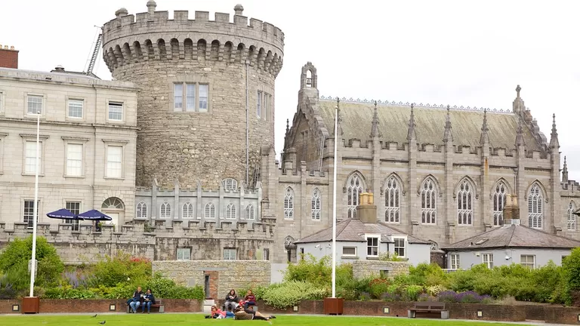
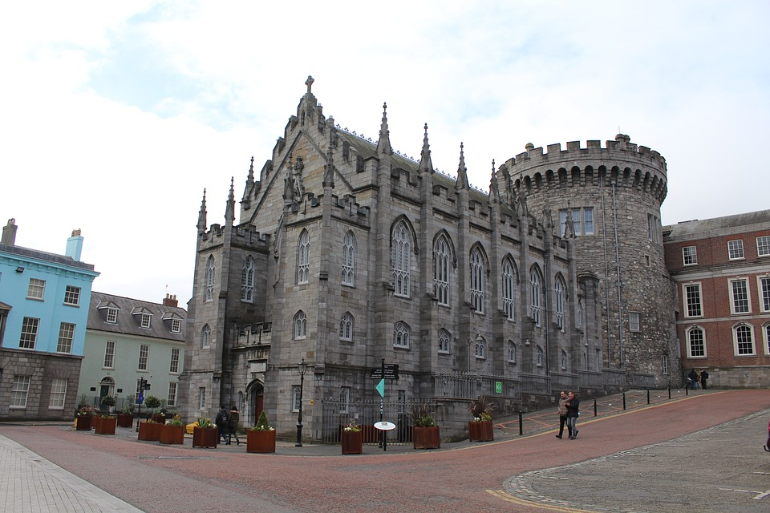
King John had Dublin Castle built, & the Irish parliament operated from there. Don’t be fooled by the words “Irish parliament”: almost all the members were English in origin, not Irish. The parliament met for the first time in 1297, and the concerns on the agenda included territorial encroachment by the native Irish on English (ahem) lands and the bad English spoken in Ireland. They didn’t phrase it that way, of course, but the English of people living in Ireland was bound to change in ways different from the way it was changing in England—that’s how we end up with dialects & then new languages, remember—and the aristocracy in close contact with England didn’t much like hearing the king’s English spoken badly. (It probably even included a few Gaelic words. Imagine!)
Of course, land & language were only part of the problem. The English wanted to keep the English of Ireland English, so they demanded punishment for “those who adopted the Gaelic language, dress, haircut, & mode of riding” (Bartlett, p. 50). John had been far, far ahead of his time, because this antipathy toward the Irish & what amounted to a goal to obliterate their culture became a recurrent theme for centuries.

Slide 10
Let’s pause a moment to consider the population makeup of Ireland at this point. Those who had come around the same time as Strongbow were called Anglo-Norman. Remember, that was 1165-1172 or so, about a century after the Battle of Hastings. Just in case you missed that day in high school, the 1066 Battle of Hastings was when William the Conqueror, of Normandy, France, conquered England. A century after that, there were Anglo-Norman nobles, & it was primarily those nobles that Leinster hired as mercenaries. The “bad English” mentioned in the 1297 Irish parliament would have been spoken by the descendants of those Anglo-Normans who, predictably, were becoming more and more Gaelic, since they’d made a life for themselves among the native Irish.
Besides the Anglo-Normans & the native Irish, there were also British colonists who’d come to Ireland in search of more opportunities than they’d had at home. Ireland was home to these three groups, and then there were the English who did not consider Ireland home but did consider themselves the masters of the others.
The English colonists had, from their point of view, the roughest time of it, because they felt suppressed by the Anglo-Normans, who wouldn’t support them against the Irish. Still considering themselves English, they appealed to the Irish parliament, who, in 1366, enacted the Statutes of Kilkenny.
The Statutes of Kilkenny essentially formalized what had been declared at the first Irish parliament. In a nutshell, everything Irish was outlawed. English & Irish could not marry, even if both were Christian. If Irish lived in English colonies, they were required to speak English, not Gaelic. Irish musicians were not allowed on English (ahem) lands because they were considered to be spies.
As you might imagine, the Irish & those who’d come to live as Irish (i.e., a great many of the Anglo-Normans & even some of the colonists) resented the statutes & pretty much ignored them. England sent a series of lords to take charge of the situation. Finally, in the 1390s, the colonists called for the king himself, Richard II, to come to Ireland. In 1394 he did, but to their dismay, he accepted submission from the Gaelic (and Anglo-Norman) lords. They pledged loyalty & promised to stop behaving Irish. Seven months after his arrival, Richard II returned to England, leaving behind Roger Mortimer, earl of March, as lord of Ireland.
Mortimer, young & power-hungry, raided Ulster & burned Armagh. He died two years later in Carlow (in Leinster) fighting the O’Byrne family (who’d ruled Leinster for generations). Richard returned in 1399 but didn’t have time to accomplish anything because he had to return home to fight a rival for his throne.

Slide 11
There was less & less money for anyone who accepted the position of lord/governor of Ireland, which was pretty much a thankless job, anyway. The solution was to find an Anglo-Norman lord to do the job. The problem with that—no surprise here—was the fighting among Anglo-Norman families for the position.
The Anglo-Normans were pretty Irish, but they still considered themselves English. As we’ve mentioned, culture & identity are a complicated matter. The Anglo-Irish spoke Gaelic, although they still sometimes used English in legal & ecclesiastical settings. They lived as the Irish did, & the English in England certainly didn’t consider them English. Six hundred years in the future, this pattern would repeat itself. But for now, let’s consider: why should people who spoke Gaelic, practiced Gaelic customs, adopted Gaelic law, & never set foot in England identify themselves as English?
Don’t look for the answer on the next slide. It’s time now for critical thinking.

